Slide 1
Bioinfo@INRA-Toulouse Helianthus annuus genome annotation HA412.v1.1.bronze.20141015 update
Sébastien Carrere¹ Ludovic Legrand¹, Jérôme Gouzy¹ Erika Sallet¹, Thomas Schiex²
¹ Laboratoire des Interactions Plantes Microorganismes (LIPM) INRA/CNRS
² Unité de Biométrie et d’Intelligence Artificielle (UBIA) INRA

Slide 2
Summary
Genome annotation
The EuGene gene finder
Sunflower bronze annotation pipeline
Annotation summary
Web tools
Genome Browser
Annotation Browser
Sequence-based tools

Slide 3
Annotation of protein coding genes EuGene: an integrative gene finder
Integration of different types of evidences
protein similarities, evidences of transcription, etc.
Alternative splicing prediction
Combiner
Integrating predictions from other gene finders (e.g FGENESH)
Result in GFF3 format
Ensuring interoperability with a large number of software and databases (chado, gbrowse, jbrowse, apollo, etc..)
Availability
Open source software (Artistic License)
http://mulcyber.toulouse.inra.fr/projects/eugene/
Foissac S, Gouzy J, Rombauts S, Mathé C, Amselem J, Sterck L, Van de Peer Y, Rouzé P, Schiex T: Genome Annotation in Plants and Fungi: EuGène as a Model Platform. Current Bioinformatics 2008, 3:87-97.

Slide 4
Sunflower EuGene pipeline

Slide 5
Sunflower EuGene pipeline
Deal with the large amount of transposable elements
Reference database contains a lot of TE
Need to clean these databases before creating similarities evidences
TE and flanking genes were collapsed
Need to consider TE Regions as non coding regions

Slide 6
Sunflower EuGene pipeline
Deal with N stretches
→ configure EuGene to allow gene prediction through 3kb gaps

Slide 7
Annotation summary
94.33 % of HA412-HO EST are correctly mapped (~90% of XRQ ESTs)
→ Gene space is covered
90935 protein coding genes
59817 with Full Length Best Hits (spanning 60% of the length of the A. thaliana | SwissProt | Unitprot_plant protein) OR « EST/RNAseq assembly » support
39050 with EST support over 80% of the mRNA
13568 gene models correspond to full length A. thaliana proteins
Lettuce Genome Assembly, Structure and Annotation (Maria Jose Truco , PAG 2014): “Genome annotation of the assembled genome using three prediction pipelines postulated a set of 94,556 non-redundant gene models. From those, 41,000 high confidence gene models were identified […] that combines transcriptomic and prediction evidence.”
Nomenclature : Ha412v1r1_LGgXXXXXX

Slide 8
Web Tools
https://www.heliagene.org/HA412.v1.1.bronze.20141015/
Login / password: see consortium

Slide 9
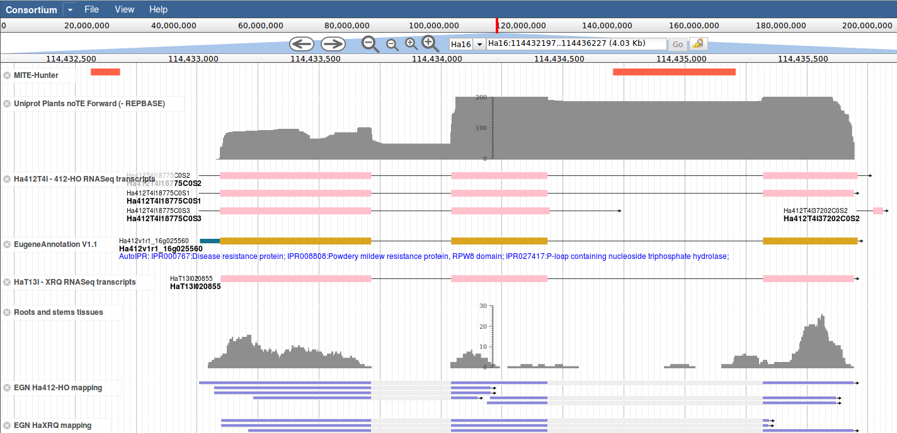
Genome Browser
Available tracks
Assembly
Gene Models (v0 and v1.1)
Protein similarities
TE predictions (MITE, LTR, BlastX)
Ha412-HO RNA-seq libraries mapping
Transcript alignments
Query with
Genomic Region
Gene locus tags
Transcripts accessions
HaT13l or Ha412T4l

Slide 10
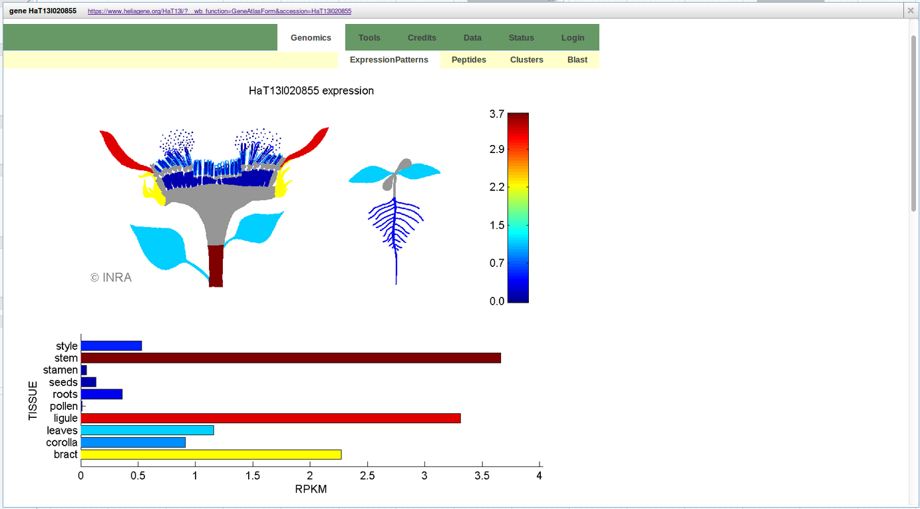
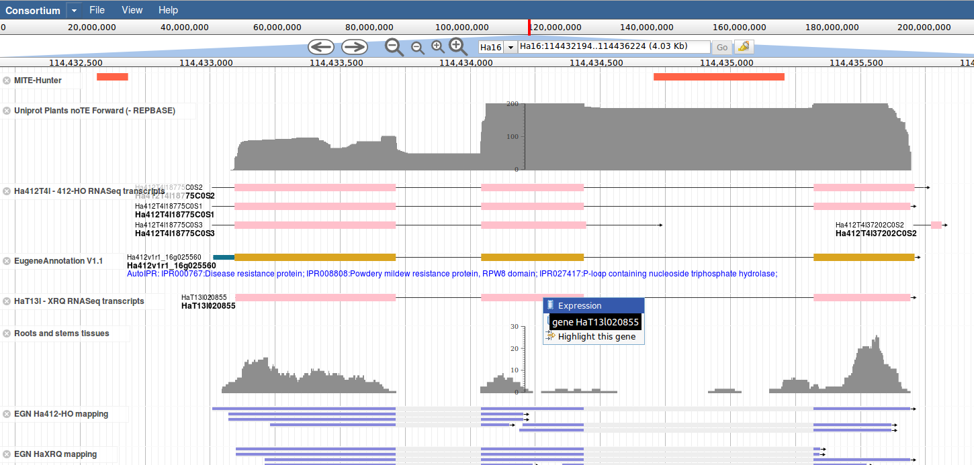
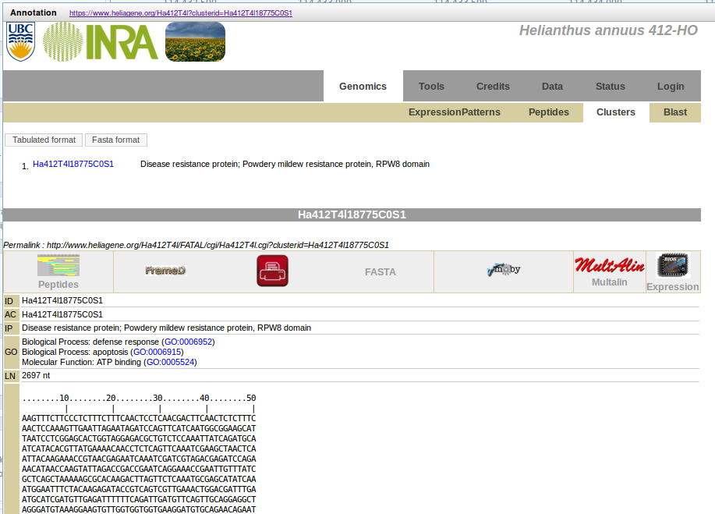
Contextual menus Linked resources

Slide 11
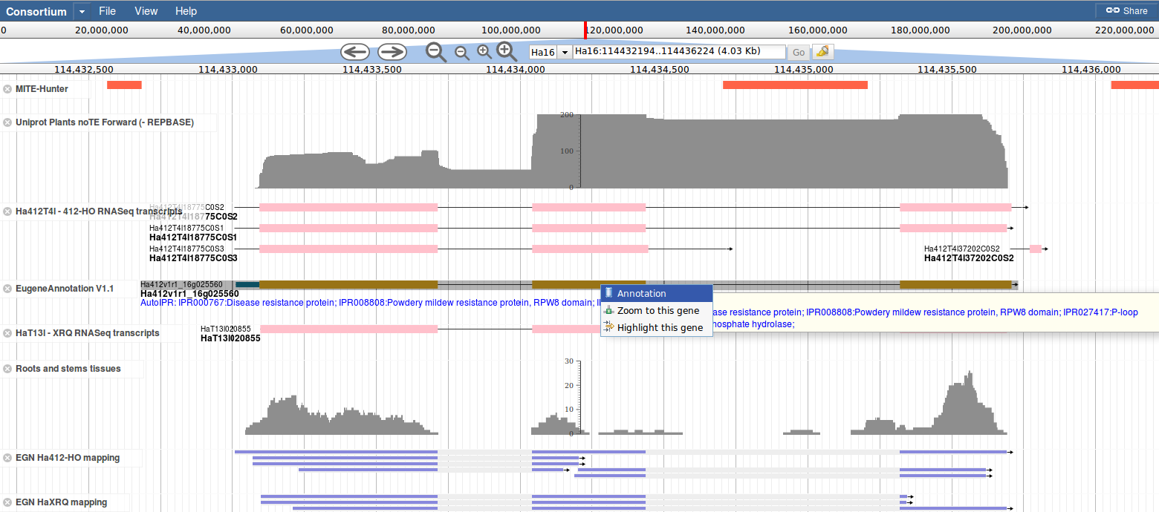
Contextual menus Linked resources

Slide 12
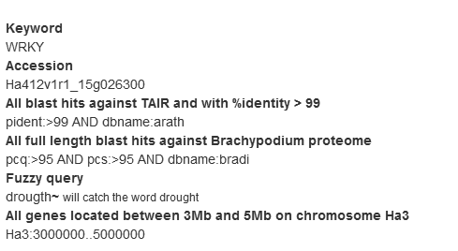
Annotation Browser
Pre-computed analysis to speed up annotation mining
Full-text search through
Automatic functionnal annotation (InterPro based)
Blast hits accessions / descriptions (Blastp vs. Uniprot-Plants, B. dystachyon, A. thaliana)
InterPro hits accessions (GO terms, database accessions – PFAM, InterPro terms)
Exact match
Partial match
Complex queries
Region search

Slide 13
Annotation Sheet

Slide 14
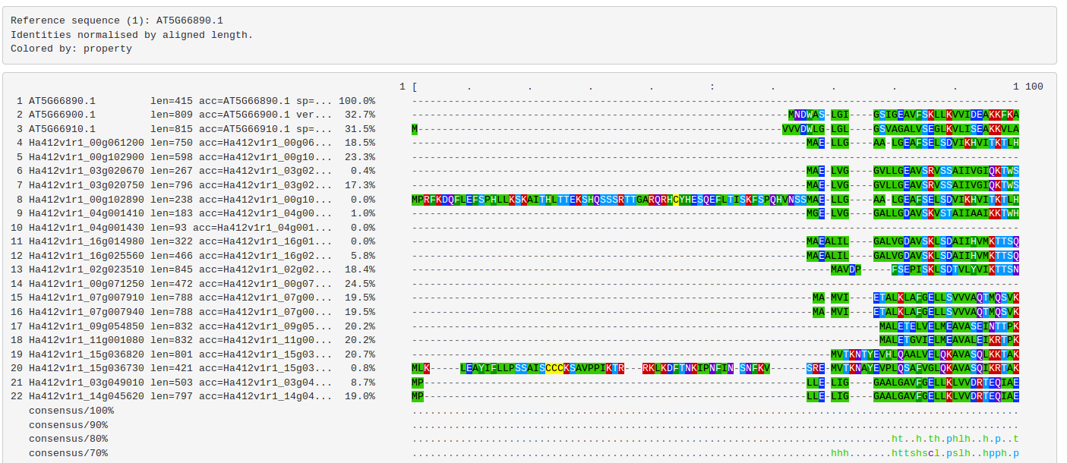
Annotation Sheet Pre-computed protein families

Slide 15
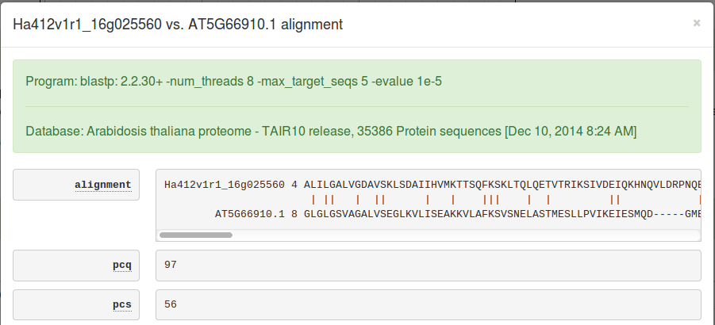
Annotation Sheet Pre-computed blast results
5 best hits with e-value < 1e-5 against
A. thaliana TAIR10
B. distachyon proteome
Uniprot-Plants

Slide 16
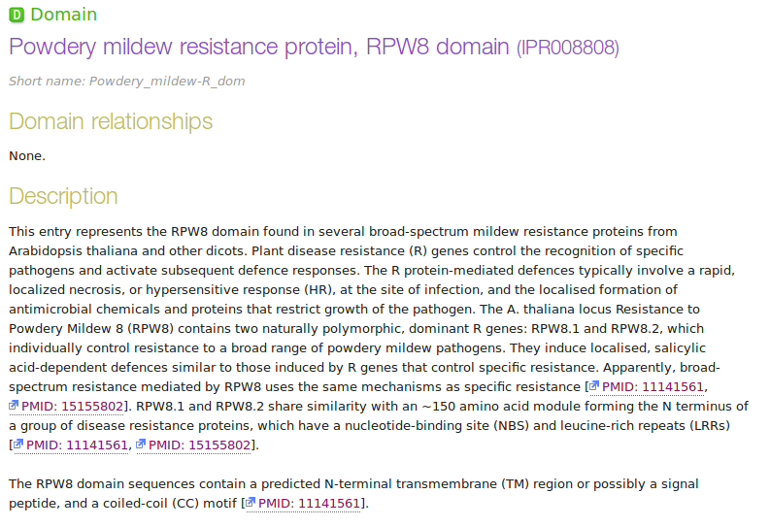
Annotation Sheet Pre-computed InterPro results

Slide 17
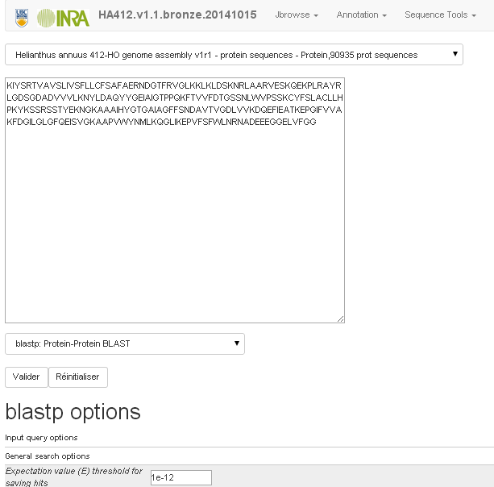
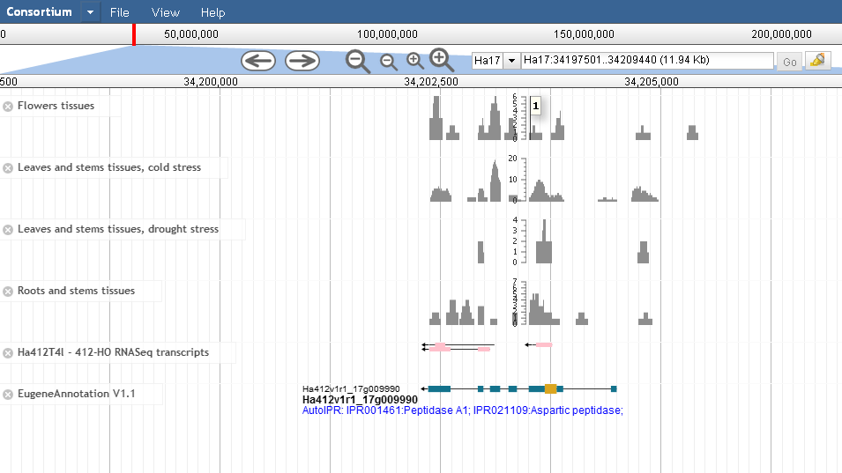
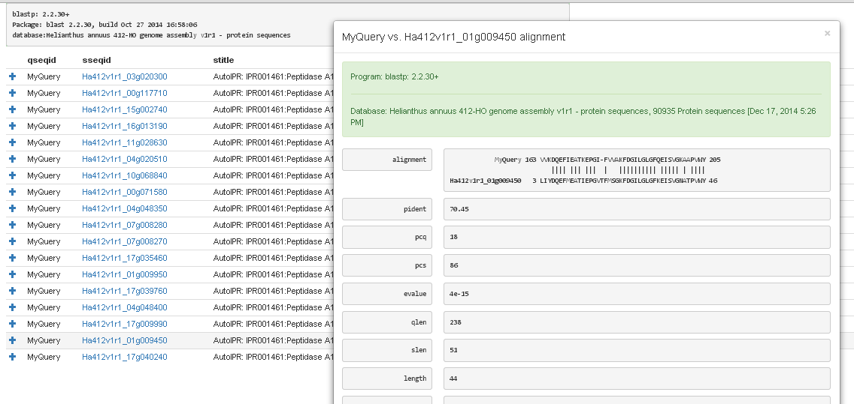
Sequence-based tools Blast server

Slide 18
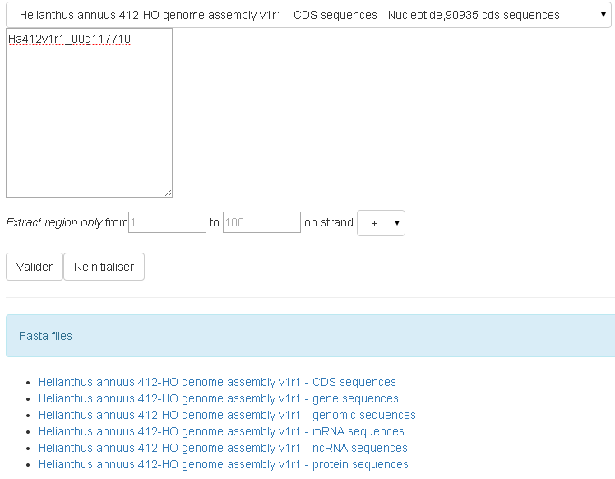
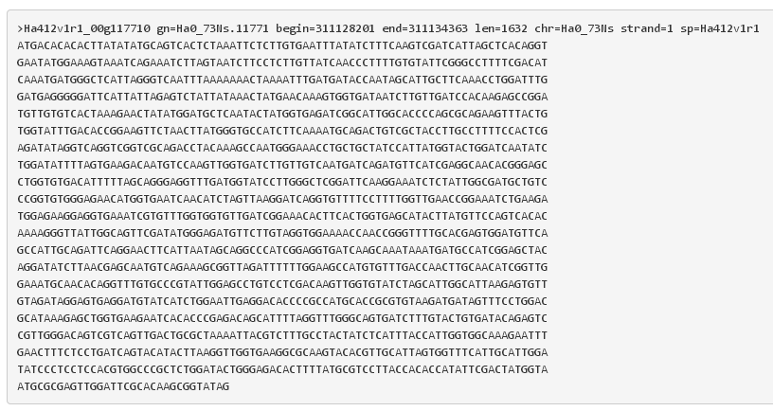
Sequence-based tools Extract-seq

Slide 19
Sequence-based tools Protein families

Slide 20
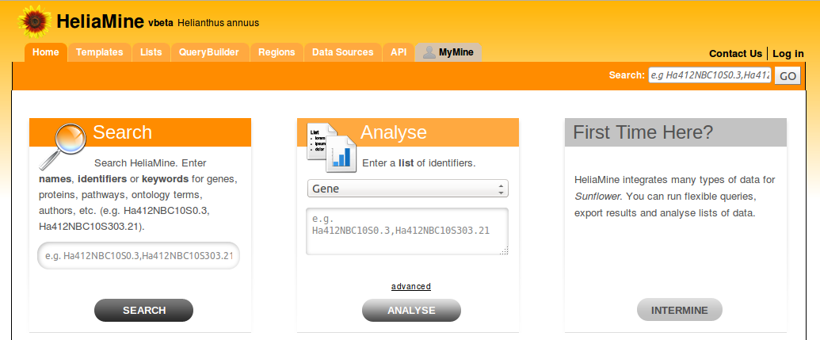
Next
Annotation components (gene structure → genome browser) will be updated/improved as soon as the gold genome assembly is available
Sequence datasets (annotations, hits) will be integrated as a new source into the HeliaMine portal
Feature request/Bug report
Jerome.Gouzy@toulouse.inra.fr
Sebastien.Carrere@toulouse.inra.fr

