Slide 1
Notes:
Thought-provocking

Slide 2
Bridging Physiological and Evolutionary
Time Scales in a Gene Regulatory Network
Case study of the
Drought Gene Regulatory Network
in Sunflower
Nicolas Langlade
INRA Toulouse

Slide 3
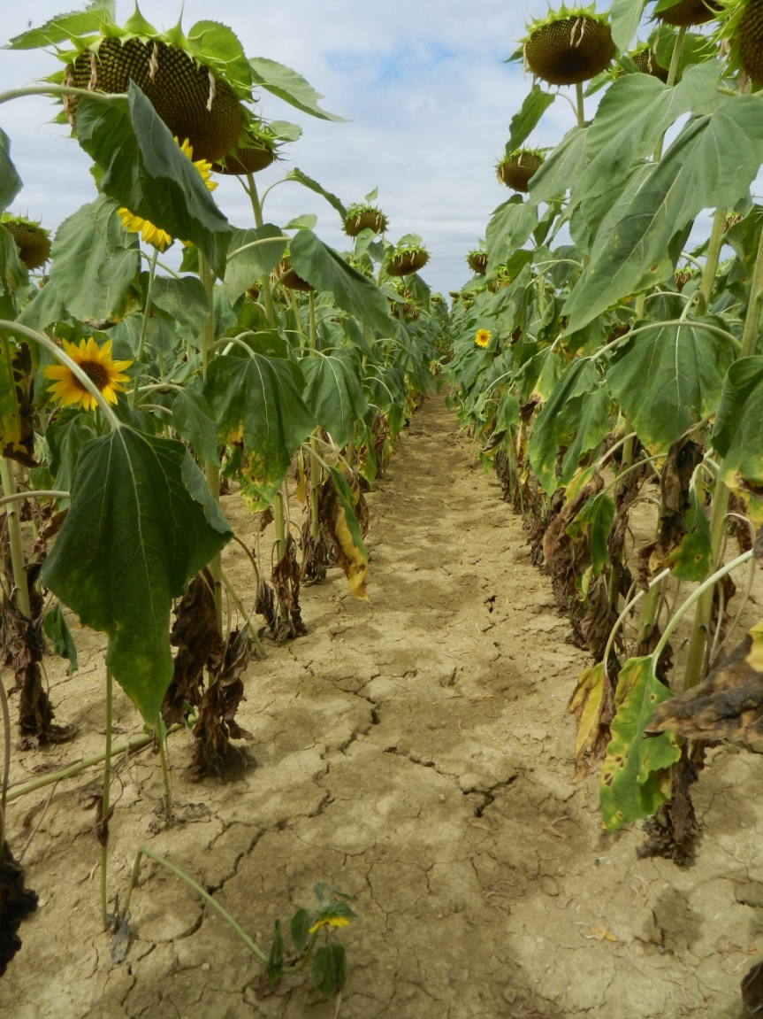
Gene Regulatory Network
Complex molecular and physiological functions
are the product of many genes that
are coordinated spacially and temporally
= GRN
Are molecular and physiological functions
related in the GRN?
Is genetic diversification constrained by the GRN?
Speciation?
Domestication?
Breeding?
Drought Gene Regulatory Network
in Sunflower
3

Slide 4
Drought Gene Regulatory Network Gene selection
Glasshouse
FTSW 0.1 vs 1
Pre-flowering
Field
FTSW 0.2 vs 0.6
Post-flowering
316
51
247
23
Rengel et al., 2012 PLoS ONE
57
16
367
Growth chamber
ABA 10µM
Plantlet
+ key genes in hormonal
signaling pathways
= 182 genes selected
4

Slide 5
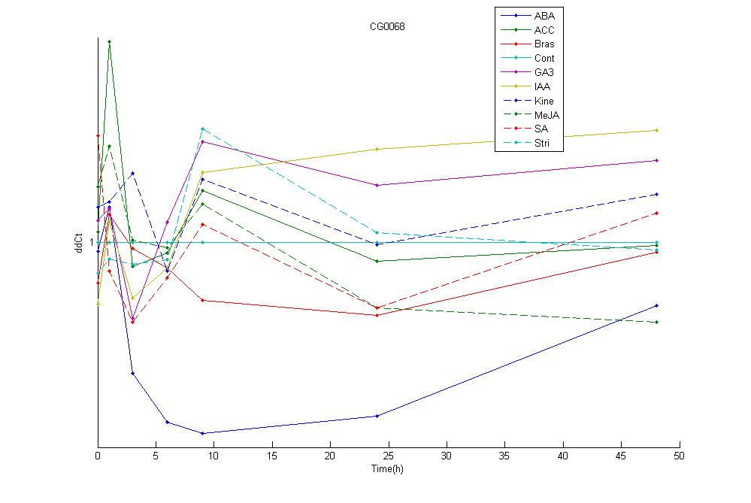
Drought Gene Regulatory Network Gene selection
Glasshouse
FTSW 0.1 vs 1
Pre-flowering
Field
FTSW 0.2 vs 0.6
Post-flowering
ABF2
316
51
247
23
ΔΔCt
57
16
367
Growth chamber
ABA 10µM
Plantlet
Time (h)
7 Times
9 Hormones
3 Repeats
+ key genes in hormonal
signaling pathways
= 182 genes selected x
5

Slide 6
Drought Gene Regulatory Network Inference Methodology
Goals of the modeling:
Obtain a meta-network
Identify hormone-specific edges/pathways
Nature of the prediction
Oriented edges
Statistical methods
performed by M. Vignes (INRA Toulouse) and P. Geurts and V.-A. Huynh-Thu (U. Liège)
Gaussian Graphical Model
SIMoNe (J. Chiquet, Evry)
Random Forest
GENIE3 (P. Geurts, Liège)
Gene i
Time = t
Gene j
Time = t+1
META-ANALYSIS
described in Marchand et al. 2014 Supp. Mat.
6

Slide 7
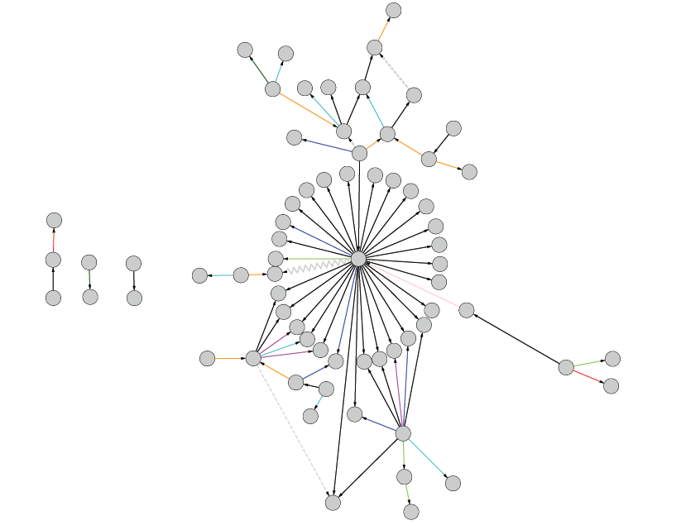
Sunflower drought GRN
69 genes
2/3 from sunflower transcriptomic studies
1/3 from model species data
79 edges
Several hormones
ABA
Ethylene
Me-Jasmonate
…

Slide 8
GRN topological parameters
Average Shortest
Path Length
Degree of
connectivity
What is the relation between molecular functions are position in the GRN?
What is the link between genetic diversity and position in the GRN?

Slide 9
Low degree of connectivity:
Enzyme activity
Metabolic process
Redox activity
ATP binding
Protein phosphorylation

Slide 10
ABF2
Intermediate degree of connectivity:
Transcription Factor
Chromatin interaction
DNA binding to specific sequence
MYC2

Slide 11
High degree of connectivity:
Transporter
Ion Channel
Cl⁻ and NO₃⁻
CLC-A
NRT1.1

Slide 12
Links from literature
ABA
Links inferred in the GRN :ABA dependent pathway
Links inferred in the GRN : ABA independent pathway
SULTR1
ABF2
NRT1.1
CLC-a
HaT13l
028104
PMEAMT
GUN5
HAB1
HaT13l
074901
PLD α2
APX1
ARIA
CPK5
MYC 2
CCT2
Emb1075
ABA1
Anion transporter
JA
Cell protection
Signal transduction
Transcription factor
Genes involved in ABA pathways
12

Slide 13
How GRN can allow or constrain evolution?
Domestication
Local adaptation

Slide 14
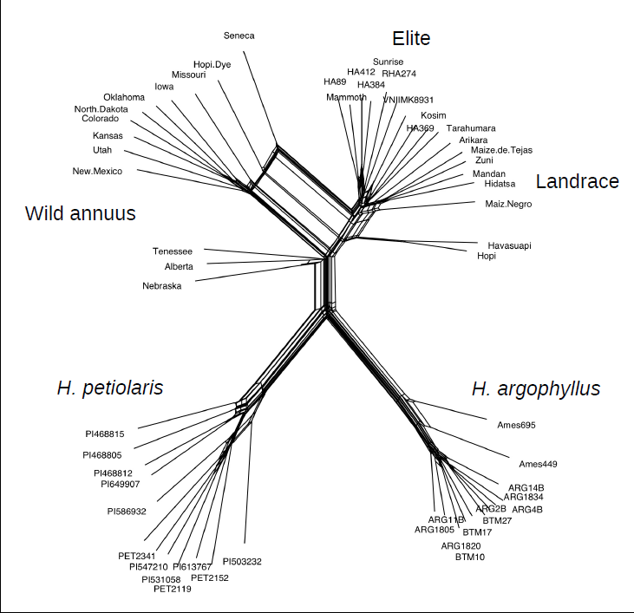
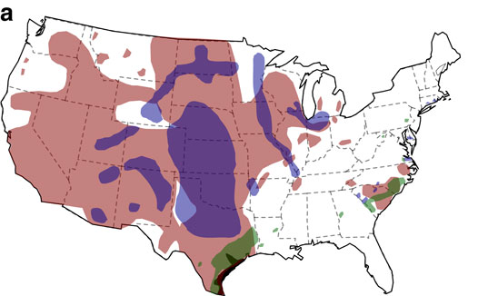
Genetic diversity in the drought GRN
H. annuus
H. petiolaris
H. argophyllus
Collaboration N. Kane & L. Rieseberg
(UC Boulder & UBC Vancouver)
Map from Renault et al., 2013, Nat Comm
14

Slide 15
Genetic diversity in the drought GRN
H. annuus
GRN level
No significant correlation between
topological parameters and F_{ST}
Gene level
NRT1.1 (hub)
Significant loss of diversity
in H. argophyllus
H. petiolaris
H. argophyllus
? Evolution of the topology of the GRN during speciation
15

Slide 16
Genetic diversity in the drought GRN
GRN topology parameters , F_{ST}
rho = 0.946, p=0.002
Wild
H. annuus
Elite
H. annuus
ASPL, F_{ST}
R = 0.74, p=0.003
Landrace
H. annuus
GRN topology parameters , F_{ST}
rho = 0.976, p=10⁻⁴
Average Shortest
Path Length
16

Slide 17
Who constrains who?
17

Slide 18
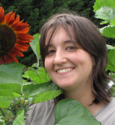
Many thanks to our collaborators
G. Marchand
Publication: Marchand et al. 2014 New Phytologist (arXiv)
Statisticians: M. Vignes (INRA Toulouse) and Pierre Geurts and V-A Huynh-Thu (U. Liege)
Evolutionary Biologists: N. Kane (UC Boulder and L. Rieseberg UBC Vancouver)
Genetics: P. Vincourt, S. Muños, B. Mangin
Bioinformatics: J. Gouzy, S. Carrère
Sunflower biotech and breeders: Biogemma, RAGT 2N, Soltis, Syngenta
Notes:
15 mins to present our research program, the strategy, the results,

