Slide 1
Evaluation of PacBio sequencing to improve the sunflower genome assembly Stéphane Muños & Jérôme Gouzy Presented by Nicolas Langlade

Slide 2
Recent experiences with PacBio data
at a locus scale level (Sunflower)
at a genome scale level (fungus)
Confidential, for internal communication only

Slide 3
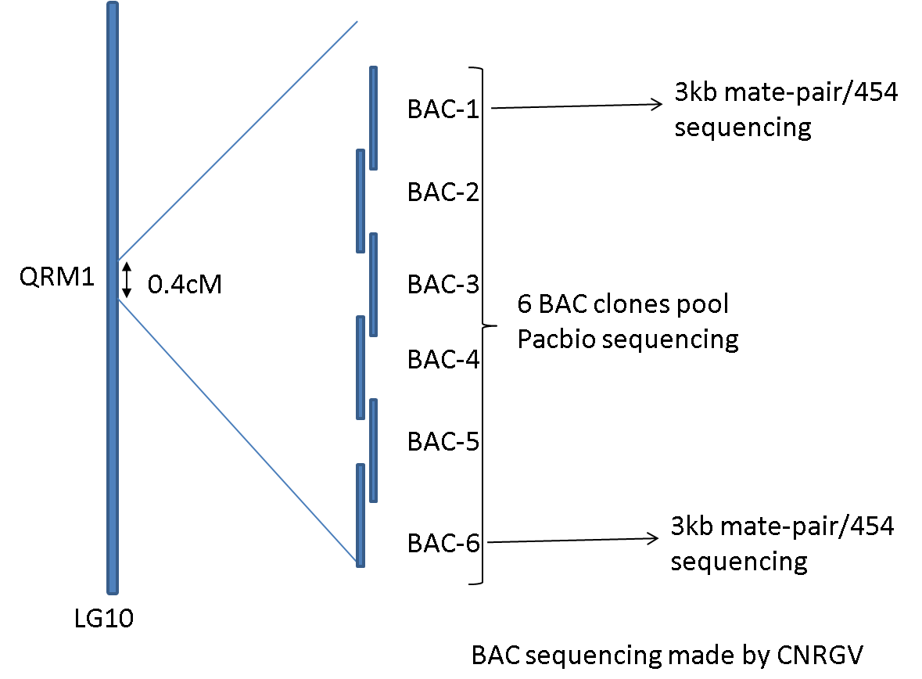
Map based cloning of a downy mildew resistance locus
Stéphane Muños
QRM1 in a 0.4cM window, partially covered by a contig of 6 BAC clones
Confidential, for internal communication only

Slide 4
Results using Roche 454 MP
BAC-1 (160.3kb)
2 scaffolds, 11 contigs (5+6).
NUM 2
MIN 73144
MAX 76146
N50 BP 76146
N50 NUM 1
MEAN 74645.00
MEDIAN 73144
BP 149290 (3.5% N)
(coverage : ~90%)
BAC-6 (147.1kb)
2 scaffolds, 12 contigs (9+3).
NUM 2
MIN 21016
MAX 110513
N50 BP 110513
N50 NUM 1
MEAN 65764.50
MEDIAN 21016
BP 131529 (2.1% N)
(coverage : ~87%)
~ 15kb of missing sequences
~ 19kb of missing sequences
At least 10% of missing sequences at a BAC clone level
➔ Very very hard to assemble Sunflower even at a micro scale
Confidential, for internal communication only

Slide 5
PacBio assembly (CNRGV data and assembly)
NUM | 63,068
MIN | 500
MAX | 30,506
MEAN | 5,738
MEDIAN | 4,804
BP | 361,884,184
PacBio assembly pipeline
A single 740kb contig for the 6 BAC clones, no N !!!
Confidential, for internal communication only

Slide 6
PacBio assembly evaluation
Do we find the correct size of the BACs in the assembly?
BAC insert sizes: alignments of Sanger BAC end sequences vs agarose gel estimation
BAC | BLAST | AGAROSE
BAC6 | 147.1 | 150
BAC1 | 160.3 | 160
BAC2 | 123.5 | 118
BAC3 | 196.5 | 190
BAC4 | 194.1 | 190
BAC5 | 150.5 | 146
Highly consistent assembly
Confidential, for internal communication only

Slide 7
PacBio assembly evaluation
Do we find back the Illumina sequence tags of the BACs?
In silico digested tags vs « keygene » Illumina FPC tags (100% identity over 100%length)
BAC1: 38/38
BAC2: 19/20
BAC3: 27/28
BAC4: 42/44
BAC5: 32/36
BAC6: 37/40
95% of the FPC tags
➔ High quality of the sequence
Confidential, for internal communication only

Slide 8
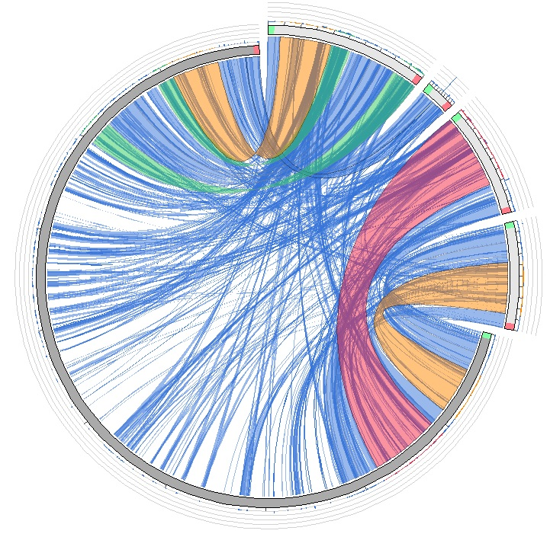
Evaluation of the repeats at a micro-scale level
BAC6-scaffold 1
BAC6-scaffold 2
454 sequencing
BAC1-scaffold 1
BAC1-scaffold 2
PacBio-contig
PacBio reads
NUM 63068
MIN 500
MAX 30506
MEAN 5738
MEDIAN 4804
A lot of repeated sequences with high identity
➔ Long PacBio reads span the sunflower repeats
Confidential, for internal communication only

Slide 9
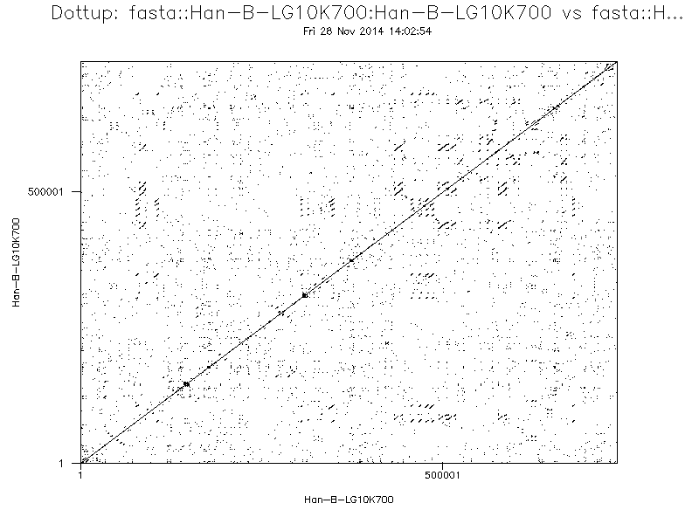
Repeats analysis of the PacBio contig
Impressive number
of repeats
INSIDE the contig
Only 1/3 covered
Confidential, for internal communication only

Slide 10
Comparison with the bronze assembly
In terms of nucleotides without N the bronze assembly corresponds to
1/3 of the PacBio contig
➔ Based on primary analyses, the bronze assembly seems to be good at the macro level but still fragmentary at the micro level
Confidential, for internal communication only

Slide 11
Fungus genome
Jérôme Gouzy
Comparison of the sequencing techniques for de novo genome assembly
20X 454
NUM 550
MIN 1 000
MAX 867 920
N50 BP 194 032
N50 NUM 41
MEAN 46 651
MEDIAN 3 777
BP 25 658 516
%N 3.7%
Illumina paired-end 1000x, mate pair 3, 8 et « 20 » kb
NUM 401
MIN 1 001
MAX 1 358 271
N50 BP 313 520
N50 NUM 25
MEAN 68 987
MEDIAN 14 860
BP 27 663 995
%N 5%
PacBio
NUM 25
MIN 21845
MAX 4 060 456
N50 BP 1 739 955
N50 NUM 6
MEAN 1 194 760
MEDIAN 1 059 621
BP 29 869 023
% N 0%
Bioinfo: several months
Bioinfo: one day !
Confidential, for internal communication only

Slide 12
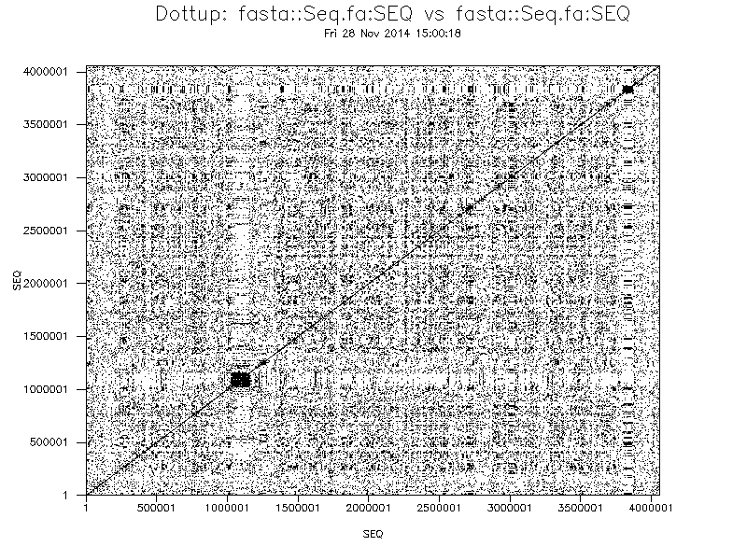
Repeats in the fungus genome
Pacbio chemistry « early 2014 » P5/C3
NUM 658 501
MIN 50
MAX 33 585
MEAN 7 925 <<<<<
MEDIAN 7 213
BP 5,2Gb (~150x)
Long reads can solve the assembly of very very cryptic chromosomes
Confidential, for internal communication only

Slide 13
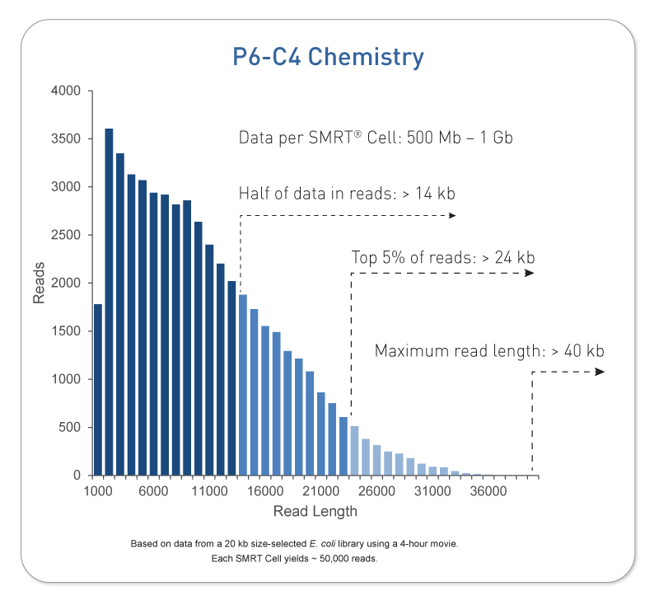
Proposal: sequence the full sunflower genome using Pacbio
Lastest chemistry better than the ones we tested (~14kb vs 8kb)
➔ 360 Gb to sequence = target 100X coverage
➔ 700Mb / SMRT cell
515 SMRT Cell
Quote in progress
6months of ~full time of the machine throughput
Confidential, for internal communication only

Slide 14
Next Steps (2015)
The SUNRISE project will dedicate part of the « genomic resources » WP budget (leader S. Muños)
Organization of the sequencing with the latest chemistry on at least 2 platforms
Evaluate the need to integrate previous data in the assembly process
Evaluate the need of optical mapping (cost/density)
Confidential, for internal communication only

Slide 15
Next Steps (2016)
Annotation of the “PacBio” assembly
Development of the web portal for the “PacBio” assembly
Integration of the different type of data (Expression, SNPs…)
Any suggestion!!!
Confidential, for internal communication only

