Slide 1
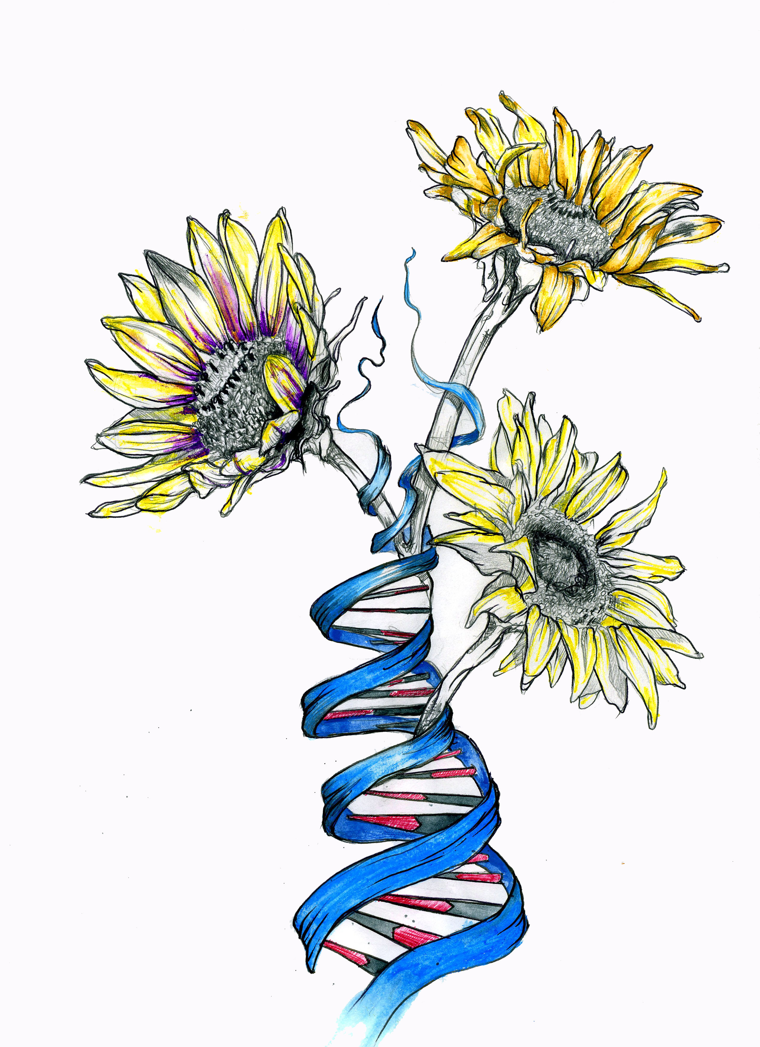
Sunflower Genomic Resources Consortium – Update Meeting
Overall Project Goals:
assemble, annotate, and curate the sunflower reference genome;
integrate the reference sequence with genetic and physical maps, EST collections, diversity panel sequences, wild species genomes, and QTL and association mapping data;
provide bioinformatics tools to efficiently browse and search the data; and
offer workshops that provide training in the use of these resources and tools.

Slide 2
Progress
First real reference sequence now complete and annotated and a more polished version is close to completion;
Extensive transcriptome and whole genome shotgun data available for hundreds of cultivated and wild genotypes;
Alignment and variant calling completed for 288 cultivated genotypes and analyses of wild genotypes underway.
Numerous bioinformatics tools and data analysis pipelines made available to efficiently browse, search, and analyze the data;

Slide 3
Plans for 2015 and 2016?
2015:
Annotate gold reference sequence;
Complete alignment and variant calling of existing whole genome shotgun sequence;
Continue bioinformatics tool development;
Sequence genome with PacBio to 50-100x depth (INRA)?
2016?
Assemble and annotate PacBio reference sequence
Integrate with genetic and physical maps, etc.
Genotype 1,500 wild genotypes
Deliver candidate genes for agriculturally important traits

Slide 4
Proposed Changes to Data Access
Make Sunflower Genome Database public
Private early access genomic resources made available exclusively on Heliagene, which is maintained by INRA

Slide 5
Agenda
10:30 am Introductions and overview of sunflower genomic resources (L. Rieseberg)
10:50 am Reference Genome of Sunflower: Version 1.4 (Chris Grassa, UBC)
11:20 am Web resources to browse the functional annotation of the sunflower genome (Sébastien Carrere, INRA)
11:50 am Development of a high-throughput analytical pipeline to explore sunflower genomics (Sariel Hubner, UBC)
12:20 pm Lunch (use meeting vouchers)
1:30 pm Shared patterns of repeat composition in Helianthus provide insight into the history of sunflower genomes (Evan Staton, UBC)
1:50 pm Preliminary methylome sequencing in sunflower (Adam Bewick, UGA)
2:10 pm Feedback of Pacbio sequencing in sunflower and highly-repeated element species and opportunities to improve the sunflower genome sequence (Nicolas Langlade, INRA)
2:30 pm Coffee / Tea break
2:50 pm Future of Sunflower Genomic Resource Consortium (Discussion)
3:20 pm Hands on exploration of genomic resources
4:00pm Adjourn

